Slide 1
ADVANCED FUNCTIONS
6.0001 LECTURE 6 1

Slide 2
DECOMPOSITION, ABSTRACTION, FUNCTIONS

Slide 3
Focus on important functionality by using Abstraction
in projector example, instructions for how to use it are
sufficient, no need to know how to build one
in programming, think of a piece of code as a black box
  If you do not need or want to see details not relevant to function
achieve abstraction with function specifications or
docstrings
10

Slide 4
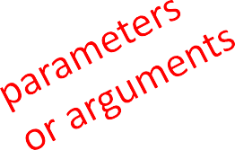

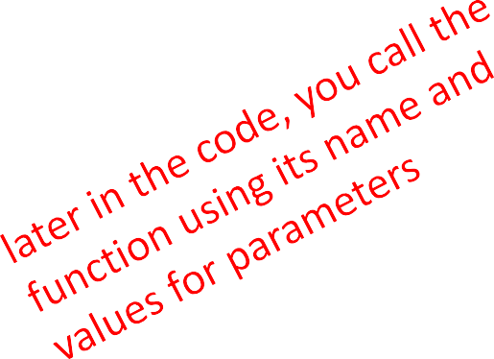
HOW TO WRITE and
CALL/INVOKE A FUNCTION
def
is_even( i ):
"""
Input: i:int, a positive number
Returns True if i is even, otherwise False """
print("inside is_even")
return i%2 == 0
is_even(3)

Slide 5
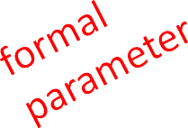
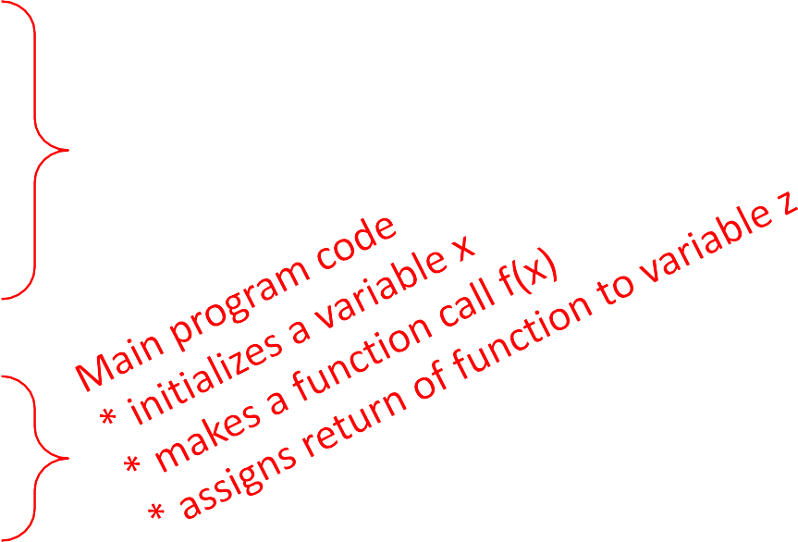
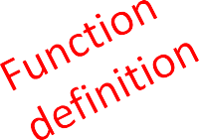
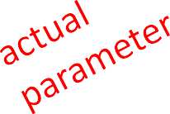
VARIABLE SCOPE
Variables with the same apparent name can reference different object in different places
formal parameter gets bound to the value of
actual parameter when function is called
new scope/frame/environment created when enter a function
scope is mapping of names to objects
def f( x ):
x = x + 1
print('in f(x): x =', x) return x
Locality and persistence or lack thereof
x = | 3
z = | f( | x | )

Slide 6
VARIABLE SCOPE
def f( x ):
x = x + 1
print('in f(x): x =', x) return x
Global scope
f
x z
f scope
x
Some
code
3
3
x = 3
z = f( x )

Slide 7

VARIABLE SCOPE
def f( x ):
x = x + 1
print('in f(x): x =', x) return x
Global scope
f
x z
f scope
x
Some
code
4
3
x = 3
z = f( x )

Slide 8
VARIABLE SCOPE
def f( x ):
x = x + 1
print('in f(x): x =', x) return x
Global scope
f scope
x
returns 4
f
Some
code
4
x
3
x = 3
z = f( x )
z

Slide 9
VARIABLE SCOPE
def f( x ):
x = x + 1
print('in f(x): x =', x) return x
Global scope
f
Some
code
x
3
x = 3
z = f( x )
4
z

Slide 10

ONE WARNING IF NO
return STATEMENT
def is_even( i ):
"""
Input: i, a positive int Does not return anything """
i%2 == 0
Python returns the value None, if no return given
represents the absence of a value

Slide 11
return
vs. print
return only has meaning
inside a function
only one return executed inside a function
code inside function but after return statement not executed
has a value associated with it, given to function caller
print can be used outside
functions
can execute many print statements inside a function
code inside function can be executed after a print statement
has a value associated with it, outputted to the console
20

Slide 12
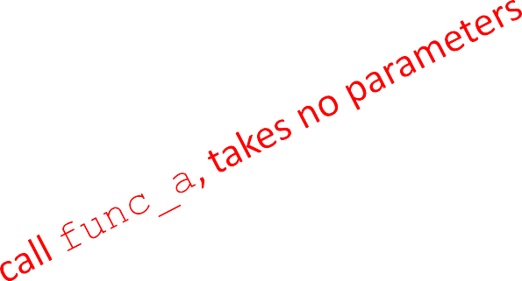
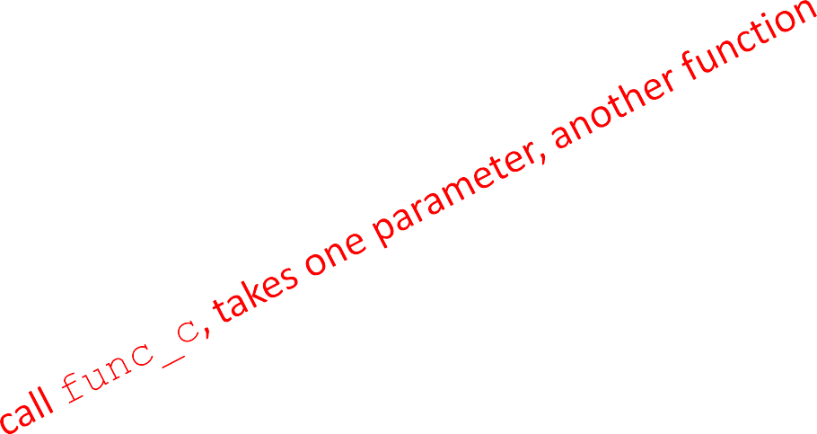
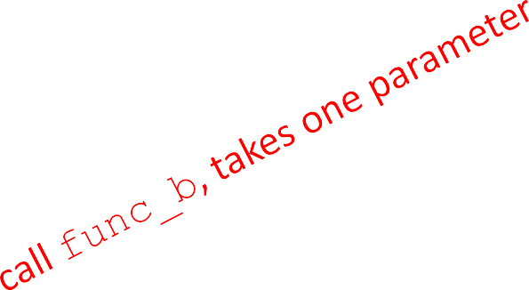
FUNCTIONS AS ARGUMENTS
arguments can take on any type, even functions
def func_a():
print 'inside func_a' def func_b(y):
print 'inside func_b' return y
def func_c(z):
print 'inside func_c' return z()
print func_a() print 5 + func_b(2) print func_c(func_a)
21

Slide 13
FUNCTIONS AS ARGUMENTS
Global scope func_a scope
def | func_a():
 | print 'inside | func_a'
def | func_b(y):
 | print 'inside | func_b'
 | return y
def | func_c(z):
 | print 'inside | func_c'
func_a
Some
code
Some code
func_b
Some code
func_c
None
returns None
return z()
print
print print
func_a()
5 + func_b(2) func_c(func_a)
22

Slide 14
FUNCTIONS AS ARGUMENTS
Global scope func_b scope
def func_a():
print 'inside func_a' def func_b(y):
print 'inside func_b' return y
def func_c(z):
print 'inside func_c' return z()
print func_a() print 5 + func_b(2) print func_c(func_a)
Some
code
2
func_a
y
Some code
func_b
Some code
func_c
None
7
returns 2
23

Slide 15
FUNCTIONS AS ARGUMENTS
Global scope func_c scope
def | func_a():
 | Print('inside | func_a')
def | func_b(y):
 | Print('inside | func_b')
 | return y
def | func_c(z):
 | print('inside | func_c')
return z()
func_a
Some
code
z
func_a
Some code
func_b
Some code
func_a scope
func_c
None
print(func_a()) print(5 + func_b(2))
7
returns None
Print(func_c(func_a))
None
returns None

Slide 16


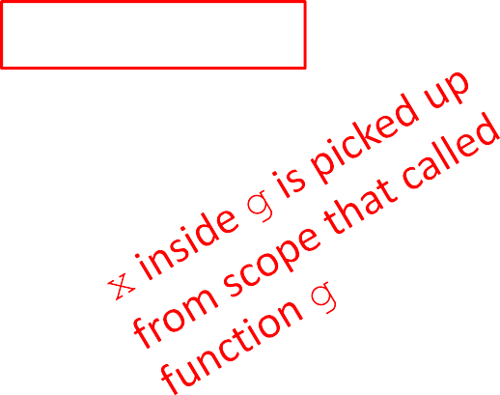
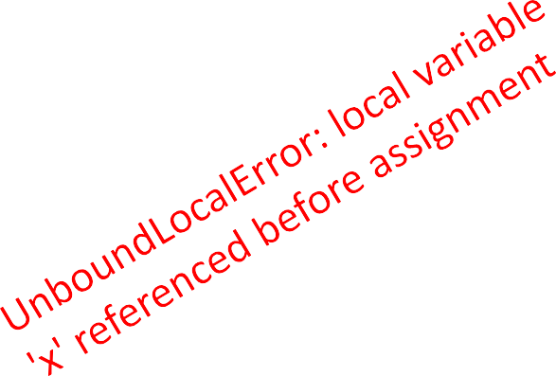

SCOPE EXAMPLE
You will use GLOBALS a lot in CC3D to create persistent variables accessible from multiple locations
inside a function, can access a variable defined outside
inside a function, cannot modify a variable defined outside -- can using global variables
def f(y):
x = 1
x += 1
print(x)
def g(y): def h(y): print(x) x += 1 print(x + 1)
x = 5
x = 5 g(x) print(x)
h(x) print(x)
x = 5 f(x) print(x)
6.0001 LECTURE 4
25

Slide 17

SCOPE EXAMPLE
inside a function, can access a variable defined outside
inside a function, cannot modify a variable defined outside -- can using global variables, but frowned upon
def f(y):
x = 1
x += 1
print(x)
def g(y):
print(x)
def h(y):
x += 1
x = 5 h(x)
x = 5 g(x)
x = 5 f(x) print(x)
print(x)
print(x)

Slide 18
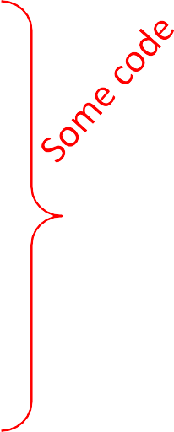
SCOPE DETAILS
def g(x):
def h():
x = 'abc' x = x + 1
print('g: x =', x) h()
Global scope
g
x
z
Some code
3
 |  | return | x
x z | = = | 3 g(x)

Slide 19
SCOPE DETAILS
def g(x):
def h():
x = 'abc' x = x + 1
print('g: x =', x) h()
Global scope
g
x
z
g scope
x
h
Some code
3
3
Some code
 |  | return | x
x z | = = | 3 g(x)

Slide 20

SCOPE DETAILS
def g(x):
def h():
x = 'abc' x = x + 1
print('g: x =', x) h()
Global scope
g
x
z
g scope
x
h
Some code
4
3
Some code
 |  | return | x
x z | = = | 3 g(x)
30

Slide 21
SCOPE DETAILS
def g(x):
def h():
x = 'abc' x = x + 1
print('g: x =', x) h()
Global scope
g
x
z
g scope
x
h
h scope
x
returns None
Some code
4
“abc”
3
3
Some code
 |  | return | x
x z | = = | 3 g(x)

Slide 22

SCOPE DETAILS
def g(x):
def h():
x = 'abc' x = x + 1
print('g: x =', x) h()
Global scope
g scope
g
Some code
x
4
Some code
x
3
h
 |  | return | x
x z | = = | 3 g(x)
None
z
returns 4

Slide 23
SCOPE DETAILS
def g(x):
def h():
x = 'abc' x = x + 1
print('g: x =', x) h()
Global scope
g
Some code
3
x
 |  | return | x
x z | = = | 3 g(x)
4
z

Slide 24
RECURSION
Recursion is the process of repeating items in a self-similar way.
Do Numpy arrays too
Show how to do COM properly!!!!
Move Recursion into discussion of functions
Put Lists and Dictionaries together and earlier
Need slides on file I/O
Print formatting
24

Slide 25
WHAT IS RECURSION?
Algorithmically: a way to design solutions to problems by divide-and-conquer or decrease-and-conquer
  reduce a problem to simpler versions of the same problem
Semantically: a programming technique where a
Function calls itself
  in programming, goal is to NOT have inﬁnite recursion
    must have 1 or more base cases that are easy to solve
    must solve the same problem on some other input with the goal of simplifying the larger problem input
25

Slide 26
ITERATIVE ALGORITHMS SO FAR
looping constructs (while and for loops) lead to iterative algorithms
can capture computation in a set of state variables that update on each iteration through loop
26

Slide 28







MULTIPLICATION –
RECURSIVE SOLUTION
recursive step
  think how to reduce problem to a simpler/ smaller version of same problem
base case
  keep reducing problem unSl reach a simple case that can be solved directly
  when b = 1, a*b = a
a*b = a + a + a + a + … + a
= a + a + a + a + … + a
= a + a * (b-1)
def mult(a, b): if b == 1:
return a else:
return a + mult(a, b-1)
28

Slide 29


FACTORIAL
n! = n*(n-1)*(n-2)*(n-3)* … * 1
for what n do we know the factorial?
n = 1
⇾
if n == 1:
return 1
how to reduce problem? Rewrite in terms of something simpler to reach base case
n*(n-1)! ⇾
else:
return n*factorial(n-1)

Slide 30
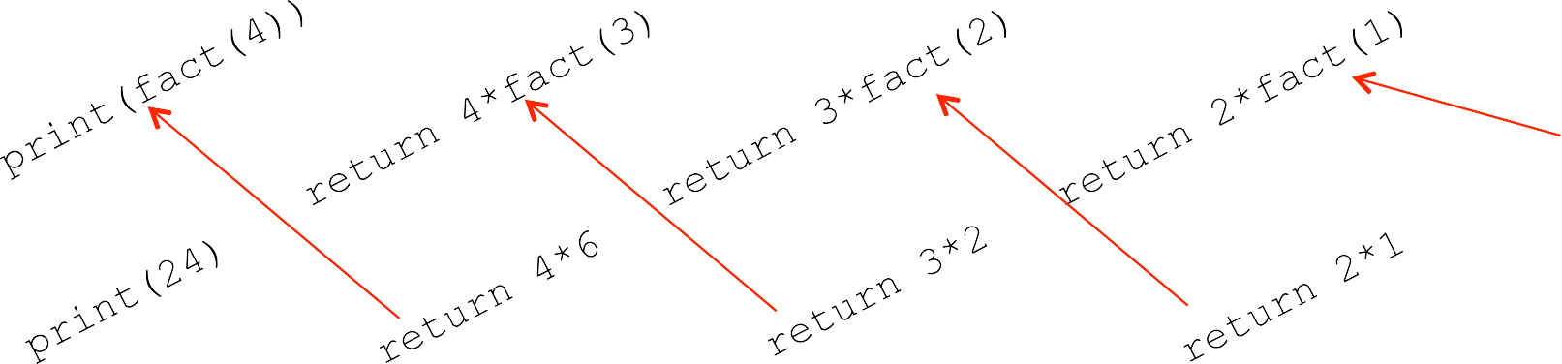
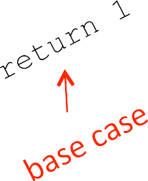
def fact(n):
RECURSIVE FUNCTION SCOPE EXAMPLE
if n == 1:
return 1 else:
return n*fact(n-1)
print(fact(4))
Global scope
fact
fact scope (call w/ n=4)
n
fact scope (call w/ n=3)
n
fact scope (call w/ n=2)
n
fact scope (call w/ n=1)
n
Some code
4
3
2
1

Slide 31
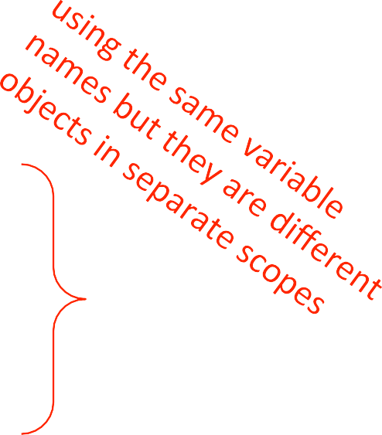
SOME OBSERVATIONS
each recursive call to a funcSon creates its
own scope/environment
bindings of variables in a scope are not changed by recursive call
ﬂow of control passes back to previous scope once funcSon call returns value

Slide 32
ITERATION vs.
RECURSION
def factorial_iter(n): prod = 1
for i in range(1,n+1): prod *= i
return prod
def factorial(n): if n == 1:
return 1 else:
return n*factorial(n-1)
recursion may be simpler, more intuitive
recursion may be eﬃcient from programmer POV
recursion may not be eﬃcient from computer POV

Slide 33
RECURSION WITH MULTIPLE BASE CASES
Fibonacci numbers
  Leonardo of Pisa (aka Fibonacci) modeled the following challenge
    Newborn pair of rabbits (one female, one male) are put in a pen
    Rabbits mate at age of one month
    Rabbits have a one month gestation period
    Assume rabbits never die, that female always produces one new pair (one male, one female) every month from its second month on.
    How many female rabbits are there at the end of one year?

Slide 34
Demo courtesy of Prof. Denny Freeman and Adam Hartz

Slide 35
Demo courtesy of Prof. Denny Freeman and Adam Hartz
23

Slide 36
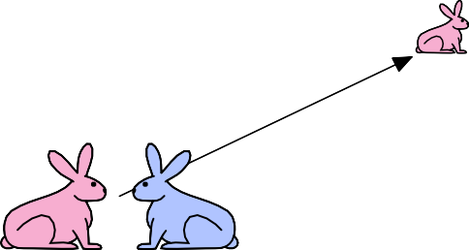
Demo courtesy of Prof. Denny Freeman and Adam Hartz

Slide 37

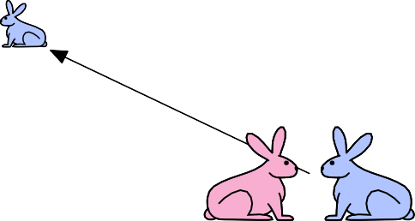
Demo courtesy of Prof. Denny Freeman and Adam Hartz

Slide 38


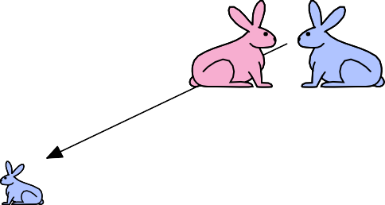
Demo courtesy of Prof. Denny Freeman and Adam Hartz

Slide 39
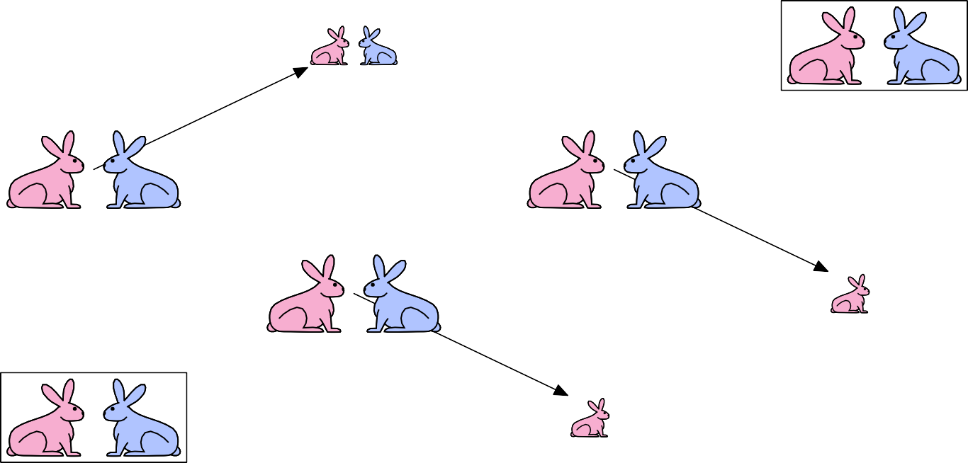
Demo courtesy of Prof. Denny Freeman and Adam Hartz

Slide 40
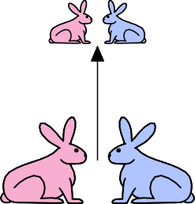

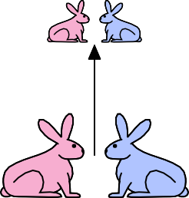
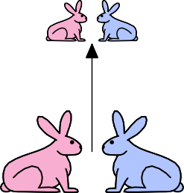


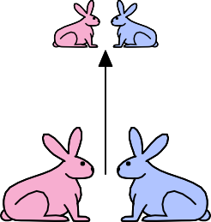

Demo courtesy of Prof. Denny Freeman and Adam Hartz

Slide 41




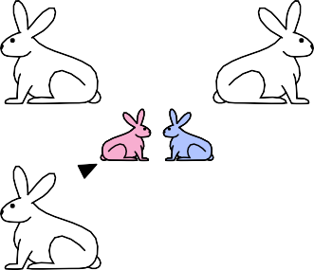




Slide 42
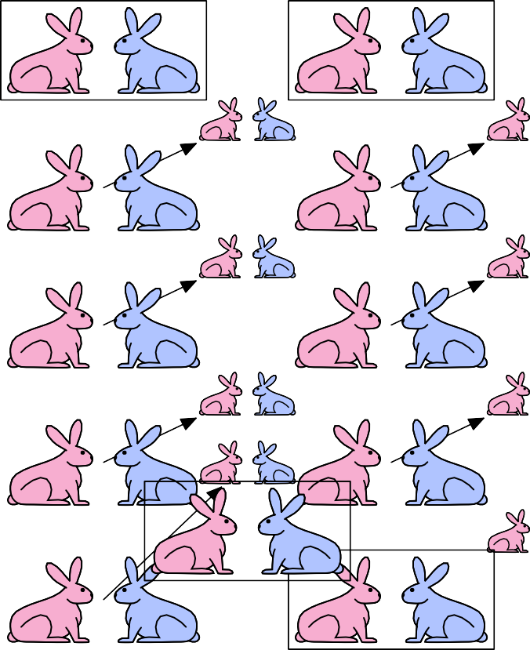
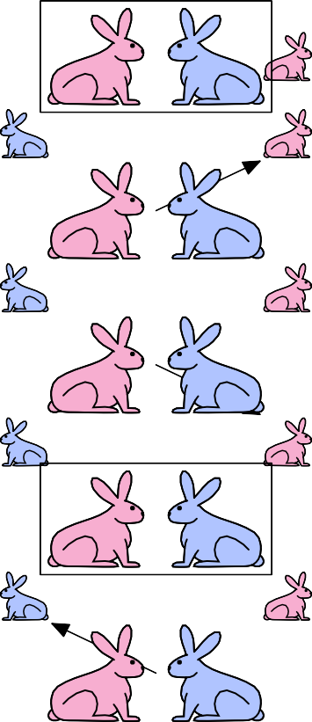
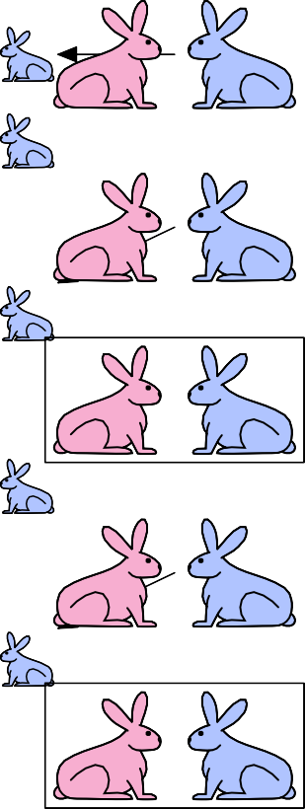
Demo courtesy of Prof. Denny Freeman and Adam Hartz
30

Slide 43
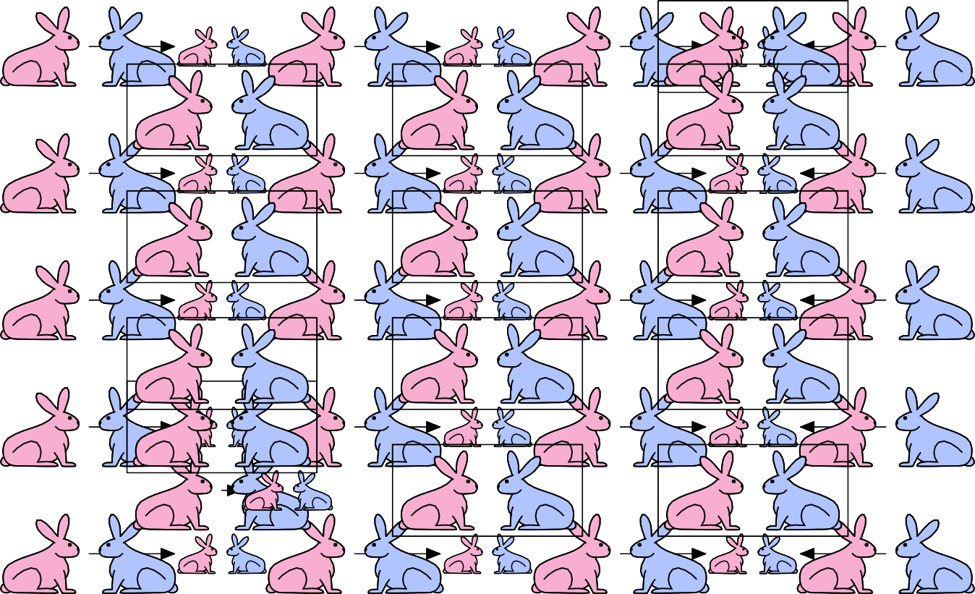
Demo courtesy of Prof. Denny Freeman and Adam Hartz

Slide 44
FIBONACCI
Ayer one month (call it 0) – 1 female
Ayer second month – sSll 1 female (now pregnant)
Ayer third month – two females, one pregnant, one not
In general, females(n) = females(n-1) + females(n-2)
Every female alive at month n-2 will produce one female in month n;
These can be added those alive in month n-1 to get total alive in month n
Month | Females
0 | 1
1
1
2
2
3
3
4
5
5
8
6
13

Slide 45
FIBONACCI
Base cases:
  Females(0) = 1
  Females(1) = 1
Recursive case
  Females(n) = Females(n-1) + Females(n-2)

Slide 46
FIBONACCI
def fib(x):
"""assumes x an int >= 0 returns Fibonacci of x""”
if x == 0 or x == 1:
return 1 else:
return fib(x-1) + fib(x-2)

Slide 47
DICTIONARIES
Dictionaries are the main way CC3D stores information about Object likes cells.
47

Slide 48

HOW TO STORE
STUDENT INFO
so far, can store using separate lists for every info
names = ['Ana', 'John', 'Denise', 'Katy']
grade = ['B', 'A+', 'A', 'A']
course = [2.00, 6.0001, 20.002, 9.01]
a separate list for each item
each list must have the same length
info stored across lists at same index, each index refers to info for a diﬀerent person
48

Slide 49
HOW TO UPDATE/RETRIEVE STUDENT INFO
def get_grade(student, name_list, grade_list, course_list):
i = name_list.index(student)
grade = grade_list[i]
course = course_list[i] return (course, grade)
messy if have a lot of diﬀerent info to keep track of
must maintain many lists and pass them as arguments
must always index using integers
must remember to change multiple lists
49

Slide 50
A BETTER AND CLEANER WAY – A DICTIONARY
nice to index item of interest directly (not always int)
nice to use one data structure, no separate lists
A list A dic0onary
0 | Elem 1
1 | Elem 2
2 | Elem 3
3 | Elem 4
… | …
Key 1 | Val 1
Key 2 | Val 2
Key 3 | Val 3
Key 4 | Val 4
… | …
50

Slide 51



A PYTHON DICTIONARY
store pairs of data
  key
  value
'Ana' | 'B'
'Denise' | 'A'
'John' | 'A+'
'Katy' | 'A'
Key 1
Val 1
Key 2
Val 2
Also explain how to search by value
Key 3
Val 3
…
…
my_dict = {}
grades = {'Ana':'B', 'John':'A+', 'Denise':'A', 'Katy':'A'}
key1 val1 key2 val2
key3 val3 key4 val4
51

Slide 52
DICTIONARY LOOKUP
similar to indexing into a list
looks up the key
returns the value associated with the key
if key isn’t found, get an error
grades = {'Ana':'B', 'John':'A+', 'Denise':'A', 'Katy':'A'}
'Ana' | 'B'
'Denise' | 'A'
'John' | 'A+'
'Katy' | 'A'
grades['John'] grades['Sylvan']
⇾ evaluates to 'A+'
⇾ gives a KeyError
52

Slide 53
DICTIONARY OPERATIONS | 'Ana' | 'B'
 | 'Denise' | 'A'
 | 'John' | 'A+'
 | 'Katy' | 'A'
 | 'Sylvan' | 'A'
grades = {'Ana':'B', 'John':'A+', 'Denise':'A', 'Katy':'A'}
add an entry
grades['Sylvan'] = 'A'
test if key in dictionary
'John' in grades 'Daniel' in grades
delete entry
del(grades['Ana'])
⇾ returns True
⇾ returns False
53

Slide 54


DICTIONARY OPERATIONS | 'Ana' | 'B'
 | 'Denise' | 'A'
 | 'John' | 'A+'
 | 'Katy' | 'A'
grades = {'Ana':'B', 'John':'A+', 'Denise':'A', 'Katy':'A'}
Fix to make l=grades.kys() so a list not a tuple!!!!
Add grades.items…
get an iterable that acts like a tuple of all keys
grades.keys()
⇾ returns ['Denise','Katy','John','Ana']
get an iterable that acts like a tuple of all values
grades.values() ⇾ returns ['A', 'A', 'A+', 'B']
54

Slide 55
DICTIONARY KEYS and VALUES
values
  any type (immutable and mutable)
  can be duplicates
  dicSonary values can be lists, even other dicSonaries!
keys
  must be unique
  immutable type (int, float, string, tuple,bool)
    actually need an object that is hashable, but think of as immutable as all immutable types are hashable
  careful with float type as a key
no order to keys or values!
d = {4:{1:0}, (1,3):"twelve", 'const':[3.14,2.7,8.44]}
55

Slide 56
list
vs
dict
ordered sequence of elements
look up elements by an integer index
indices have an order
index is an integer
matches “keys” to “values”
look up one item by another item
no order is guaranteed
key can be any
immutable type
6.0001 LECTURE 6 49

Slide 57
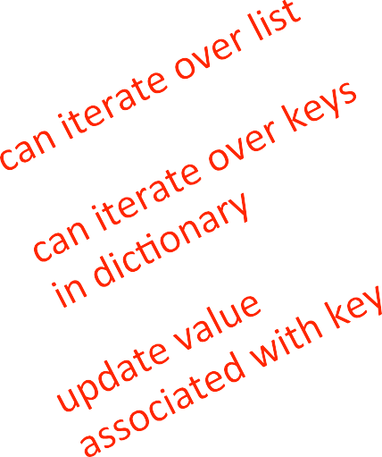
CREATING A DICTIONARY
def lyrics_to_frequencies(lyrics): myDict = {}
for word in lyrics:
if word in myDict: myDict[word] += 1
else:
myDict[word] = 1 return myDict

Slide 58
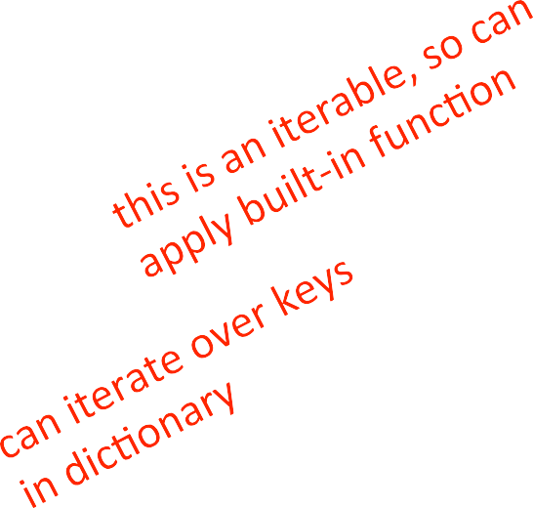
USING THE DICTIONARY
def most_common_words(freqs): values = freqs.values() best = max(values)
words = []
for k in freqs:
if freqs[k] == best: words.append(k)
return (words, best)

Slide 59
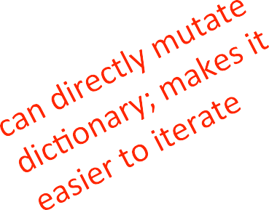
LEVERAGING DICTIONARY PROPERTIES
def words_often(freqs, minTimes): result = []
done = False while not done:
temp = most_common_words(freqs) if temp[1] >= minTimes:
result.append(temp) for w in temp[0]:
del(freqs[w])
else:
done = True return result
print(words_often(beatles, 5))

Slide 60
FIBONACCI RECURSIVE CODE
def fib(n):
if n == 1:
return 1 elif n == 2:
return 2 else:
return fib(n-1) + fib(n-2)
two base cases
calls itself twice
this code is ineﬃcient

Slide 61






INEFFICIENT FIBONACCI
fib(n) = fib(n-1) + fib(n-2)
fib(5)
fib(4)
fib(3)
fib(3)
fib(2)
fib(2)
fib(1)
fib(2)
fib(1)
Recalculating the same values many times!
could keep track of already calculated values

Slide 62
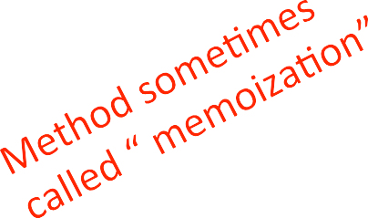
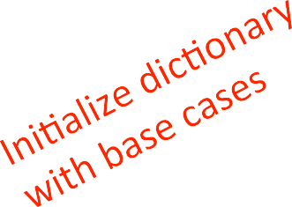
FIBONACCI WITH A DICTIONARY
def fib_efficient(n, d): if n in d:
return d[n] else:
ans = fib_efficient(n-1, d) + fib_efficient(n-2, d) d[n] = ans
return ans
d = {1:1, 2:2}
print(fib_efficient(6, d))
do a lookup ﬁrst in case already calculated the value
modify dictionary as progress through function calls

Slide 63
EFFICIENCY GAINS
Calling ﬁb(34) results in 11,405,773 recursive calls to the procedure
Calling ﬁb_eﬃcient(34) results in 65 recursive calls to the procedure
Using dicSonaries to capture intermediate results can be very eﬃcient
But note that this only works for procedures without side eﬀects (i.e., the procedure will always produce the same result for a speciﬁc argument independent of any other computaSons between calls)

