Slide 1
CC3D Workshop 3.1: Implementing the Viral Infection Model in CC3D—Part 5: Contact Killing
T.J. Sego
Dept. of Intelligent Systems Engineering
and Biocomplexity Institute
Indiana University
Bloomington, IN 47408
USA
Screensharing and microphones have been disabled for participants in the main session—they are available in breakout rooms
Please submit questions/concerns/suggestions via zoom chat
User support will be available in zoom breakout rooms
Workshop will be live-streamed, recorded and distributed
Please join the workshop slack channel at https://join.slack.com/t/multiscalemod-ags3330/shared_invite/zt-g0up1lz7-z5XGFC73UZk1j3BPeW7RVA
Funding Sources: NIH U24 EB028887, NIH R01 GM122424, NIH R01 GM123032, NIH P41 GM109824, NSF 1720625 and nanoHUB

Slide 2
Topics
Neighbor tracking
Contact surface tracking
Contact interaction modeling
Exercises
Single cell contact-killing
Full model and ODE comparison
Effects of preferential attachment

Slide 3
Before we Begin…
For this module, you can begin from Module_2.4.Version4

Slide 4

The Model… so far
$$\left\{\begin{aligned}&\frac{dT}{dt}=−βTV \\ &\frac{dI_{1}}{dt}=βTV−kI_{1} \\ &\frac{dI_{2}}{dt}=kI_{1}−dI_{2} \\ &\frac{dD}{dt}=dI_{2} \\ &\frac{dV}{dt}=pI_{2}−cV \\ &\frac{dC}{dt}=p_{C}\left(I_{1}+I_{2}\right)−c_{C}C−k_{C}C \\ &\frac{dC_{L}}{dt}=k_{C}C−c_{cl}C_{L} \\ &\frac{dE}{dt}=k_{e}E_{L}−d_{E}E \\ &\frac{dE_{L}}{dt}=p_{el}C_{L}+r_{el}C_{L}E_{L}\frac{K_{el}}{K_{el}+E_{L}}−k_{e}E_{L}\end{aligned}\right.$$
Up to this point, we have
An epithelial sheet
Viral life cycle
Inflammatory signaling
Immune cell recruitment
Motile immune cells

Slide 5
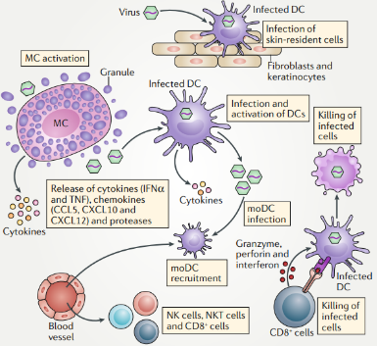
Overview of Contact Killing
Infected cells present pathogen-specific antigen
Cytotoxic T Cells are programmed to recognized the pathogen-specific antigen
Cytotoxic T Cells attach to antigen-presenting infected cells and induce apoptosis
St. John, Nat. Rev., 2019

Slide 6
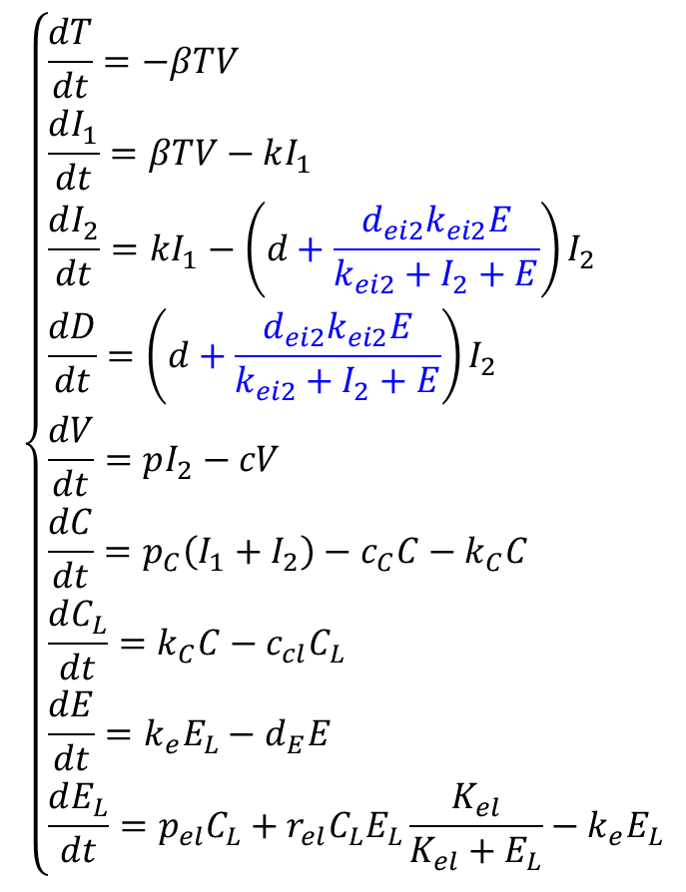
Model Components to Implement in this Module
$$\left\{\begin{aligned}&\frac{dT}{dt}=−βTV \\ &\frac{dI_{1}}{dt}=βTV−kI_{1} \\ &\frac{dI_{2}}{dt}=kI_{1}−\left(d+\frac{d_{ei2}k_{ei2}E}{k_{ei2}+I_{2}+E}\right)I_{2} \\ &\frac{dD}{dt}=\left(d+\frac{d_{ei2}k_{ei2}E}{k_{ei2}+I_{2}+E}\right)I_{2} \\ &\frac{dV}{dt}=pI_{2}−cV \\ &\frac{dC}{dt}=p_{C}\left(I_{1}+I_{2}\right)−c_{C}C−k_{C}C \\ &\frac{dC_{L}}{dt}=k_{C}C−c_{cl}C_{L} \\ &\frac{dE}{dt}=k_{e}E_{L}−d_{E}E \\ &\frac{dE_{L}}{dt}=p_{el}C_{L}+r_{el}C_{L}E_{L}\frac{K_{el}}{K_{el}+E_{L}}−k_{e}E_{L}\end{aligned}\right.$$
Contact-mediated killing!
Cytotoxic killing
Virus-releasing cells
Local immune cells

Slide 7
Add NeighborTracker Plugin
To calculate contact interactions, we need to easily access cell neighbors: NeighborTracker
In GlazierModel.xml
Add <Plugin Name=“NeighborTracker”/>

Slide 8
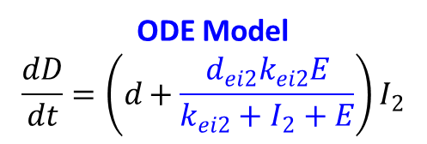
Overview of Algorithm
Virus-releasing cells are killed proportionally to ratio of their contact area with immune cells to their total available contact area
For each virus-releasing cell
Calculate the cell’s contact area with immune cells
Calculate the cell’s available contact area (i.e., not with other epithelial cell types)
Calculate the rate of contact killing
Test for immune cell killing
Implement occurrences of immune cell killing
Area ratio
ODE Model
$$\frac{dD}{dt}=\left(d+\frac{d_{ei2}k_{ei2}E}{k_{ei2}+I_{2}+E}\right)I_{2}$$
Spatial Model
$$\operatorname{Pr}\left(kill cell\right)=1−e^{−\left(d+d_{ei2}\frac{N_{e}}{η}\frac{A_{σ, E}}{A_{E}}\right)∆t}$$
From scaling
ODE coefficient

Slide 9
Starting the T Cell Killing Implementation
In steppable step()
Above secretor instantiations, add calculation of total number of epithelial cell types
After secretor instantiations, add a comment to annotate our new section on immune cell killing
Get coefficient “dei2” from ODE model and add scaling
Start a loop over all virus-releasing cells

Slide 10
Calculating Contact Interface Area: Part 1
In the for loop, initialize two variables as zero
cd8_area: total contact area with immune cells
srf_area: total contact area available

Slide 11
Calculating Contact Interface Area: Part 2
Start a for loop over the cell’s neighbors
self.get_cell_neighbor_data_list(cell) returns a tuple: neighbor, common_surface_area
neighbor: reference to neighbor cell
common_surface_area: total common surface area

Slide 12
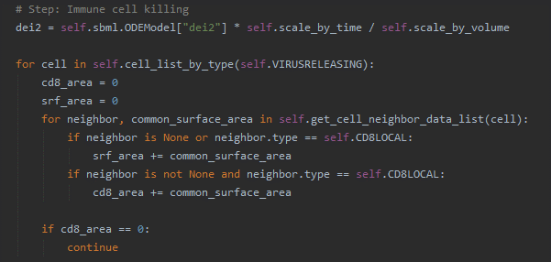
Calculating Contact Interface Area: Part 3
Check the neighbor and add common surface area accordingly
Total surface area: neighbor is the medium or an immune cell
Immune cell area: neighbor is not the medium and is an immune cell
After the neighbor loop, skip to next cell if immune cell area is zero (i.e., no killing rate)

Slide 13
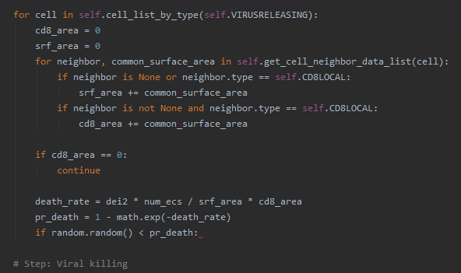
Calculating the Probability of T Cell Killing
Calculate the rate of killing
Calculate the probability of killing
Start an if block to test for killing
Spatial Model
$$\operatorname{Pr}\left(kill cell\right)=1−e^{−\left(d+d_{ei2}\frac{N_{e}}{η}\frac{A_{σ, E}}{A_{E}}\right)∆t}$$

Slide 14
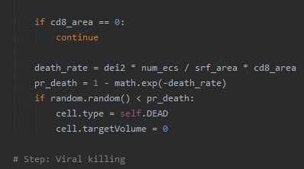
Implementing Cell Death
In the if block, implement cell death
Set cell type to Dead
Set target volume to zero
Does nothing currently
Purely for good practice (e.g., no changes required if we unfreeze cells in the future)

Slide 15
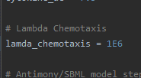
Exercise 3.1.1: Single T Cell Killing
This completes the last model mechanism!
To see how everything works, let’s observe T Cell killing by a single immune cell
At the end of steppable start()
add a single immune cell at the center of the domain
disable viral cell death: self.sbml.ODEModel[“d”] = 0
increase T Cell killing: self.sbml.ODEModel[“dei2”] *= 1E6
disable T Cell outflow: self.sbml.ODEModel[“dE”] = 0
In model inputs
increase chemotaxis: lambda_chemotaxis = 1E6
Run it!
What are the mechanisms of killing one cell to killing another?

Slide 16
Mechanisms of T Cell Killing
Beginning with a T Cell killing an infected cell
Once an infected cell dies, release of cytokine by the infected cell stops
Diffusion, decay, and release by nearby infected cells generates a new cytokine gradient
T Cell chemotaxes along the new gradient to another infected cell
Repeat.

Slide 17
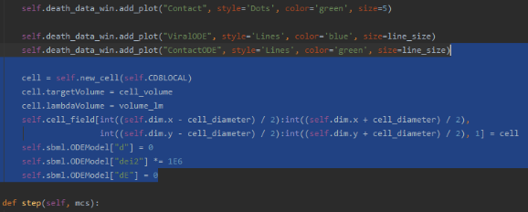
Cleanup: Remove Single Cell Experiment
Let’s finish this and set up to compare the spatial model with the ODE model
At the end of steppable start()
remove code for single cell creation
In model inputs
reset chemotaxis: lambda_chemotaxis = 1E6
Delete!

Slide 18
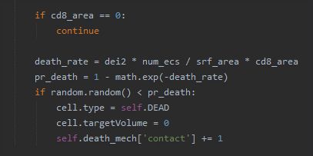
Adding T Cell Killing to Death Mechanism Tracking
Let’s add T Cell killing to death tracking
In steppable step(), increment dictionary value when T Cell killing occurs
step()

Slide 19
Adding T Cell Killing to Death Mechanism Plot Window
Let’s update the death mechanism plot window
In steppable start(), and a plot “Contact” to the death mechanism window

Slide 20
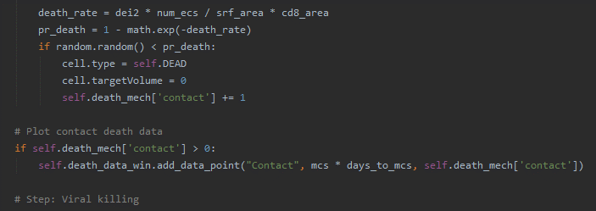
Update Death Mechanism Plotting with T Cell Killing
At the end of the T Cell killing algorithm, add loading data points for contact killing in the death mechanism window
For clean plots, only add data when nonzero

Slide 21
Exercise 3.1.2: Full Model Comparison
This model is DONE!
☺ Congrats ☺
Let’s see how it compares to the ODEs.
Run the simulation.
In the data plotting windows, how do the spatial model results (dots) compare to the ODE model results (lines)?

Slide 22
Exercise 3.1.3: Effects of Preferential Attachment
Interesting instability: preferential attachment of immune cells to infected and virus-releasing cells
When an infected cell dies, suddenly immune cell adhesion is low
Nearby cells should be infected (diffusive spread of virus), where immune cell adhesion is high
In GlazierModel.xml
set Infected — CD8Local contact coefficient to 5
set VirusReleasing — CD8Local contact coefficient to 5
set every other contact coefficient to 20
Does preferential attachment affect the curves?
If so, how, and why?

